Slide 1

Empowering Agile CPOs
AgileApt Solutions Pvt Limited

Slide 2


Introduction
AgileApt Solutions Pvt Limited - A technology company – innovative and flexible products, services and consultancy in the field of improving B2B Purchase Efficiencies (www.agileapt.com)
Our flagship product procur[E]ngine – www.procurEngine.com is an extremely reliable, effective and very easy-to-use e-Negotiation platform used by many renowned organisations
The solution is hosted on World’s one of the most secure cloud platform - Microsoft Azure and backed by Microsoft BizSpark Program. Azure is approved by Ministry of IT, Government of India, even for GoI applications
procur[E]ngine has the highest level of website Security with SSL Certification with EV Validation

Slide 3
Our Workspace
e-Negotiation adoption roadmap
B2B Vendor Discovery, Evaluation and Approval
Techno-Commercial Bid Submission, Comparative Statement and Revisions
e-Auction based Negotiation and Approvals
Purchase Portfolio Analysis
3

Slide 4
Our Offering
e-Negotiation Platform: procur[E]ngine is a subscription based model enabling clients to take advantage of e-Negotiations for negotiating and approving B2B Contracts. The platform offers
e-RFx – Detailed Techno Commercial Bid Proposal Submission, the output is the auto generated comparative statement with option of soliciting multiple revisions
e-Auctions – both Reverse & Forward, English and Dutch followed up by a workflow based approval process
Vendor Qualification – Efficient Vendor Capability Assessment Process – existing as well as new
Analytics and Reports – The system has a user friendly dashboard and multiple reports to help improving negotiation efficacy, audit compliances and system efficiencies

Slide 5
Our Offering
Contd….
e-Negotiation Training & Workshops
Purchase Portfolio Analytics
introduction of Negotiations e-Negotiations & available tools
create a perspective for the next 3-5 years on with focus on AI and ML
How organization can develop its own negotiation strategy to suit its business objectives
What are the pitfalls that every buyer should be aware of e-Negotiations
e-Negotiation Consultancy
Work closely with partner organization for successful e-Negotiation adoption

Slide 6

procur[E]ngine - Advantages
Extremely Easy to Operate
Designed to meet
complexities of B2B Negotiations
Complete security of your data
Unique Features
Loading Factor (λ-Factor)
Dutch Auctions
Staggered Auctions
Comprehensive inter-department and intra-
department approval work flows
Concept of Multiple Tagging of vendors for ease of segregation and analytics
Bidding possibility on the move, i.e. on laptop, tablet or mobile

Slide 7

procur[E]ngine - Advantages
Contd….
Cloud based SAAS model – No additional need of any hardware or software to be installed by users (including bidders)
Flexibility During Auctions
Reasonably customizable for better control on seller psychology
Multiple viewing
Extremely Transparent Pricing
Training on e-Negotiations
Tollfree support

Slide 8
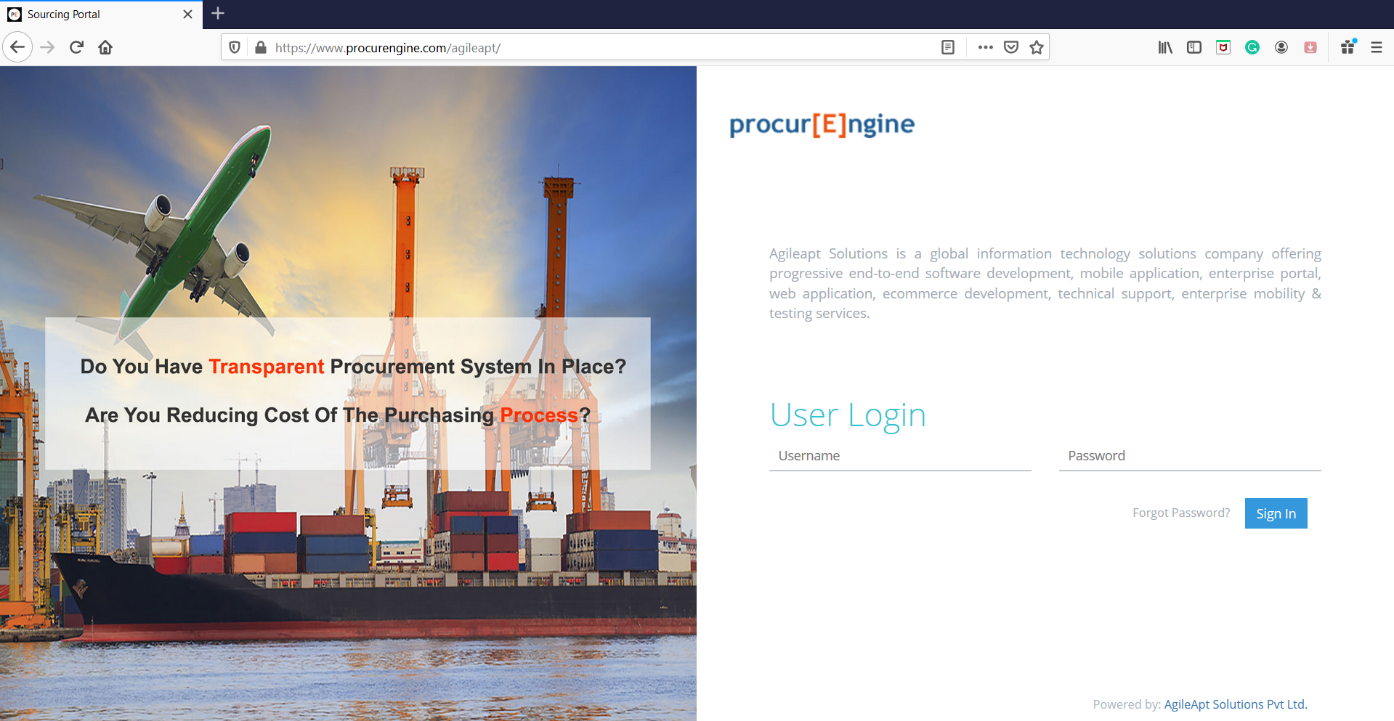
Personalization
Unique Address
Your company Logo
Your company Introduction
3 image slider for your company

Slide 9
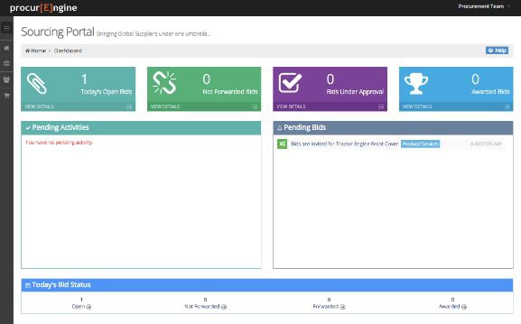
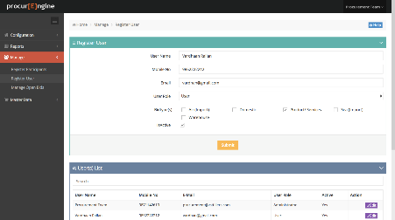
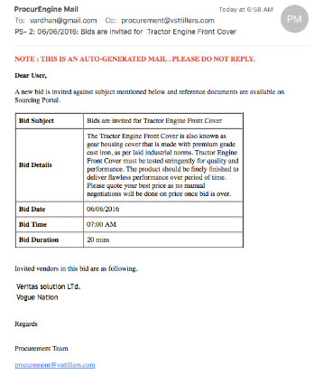
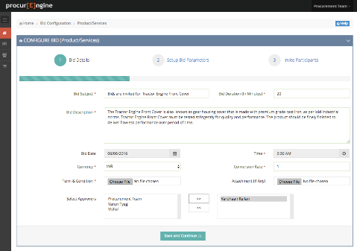
e-Auction & Approval Workflow
Every screen of bidding process is designed keeping nature of bidding and ease of use in mind. Bidding process covered in our solution are given below
Reverse Auction:
Raw Material, Products and Services
Logistics Services (Air, Sea or Domestic Shipments)
Forward Auction:
Sale of old Machinery
Scrap Sale
Discount Enhancement
e-RFQ
Inviting Quotations for complex situations
Reverse Auction is difficult
Vendor Qualification
Build your own bid qualifying criteria

Slide 10
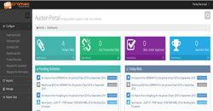
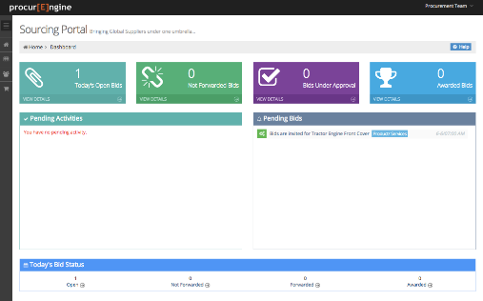
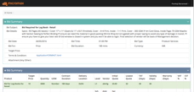
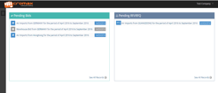
Analytics and Tools
Admin & User Dashboard
Configurable workflows
Powerful summary reports
Bidding Support Tools
Action point based application
email alerts at every action point
Role & Rights based access
Bidding area wise access rights
Service area specific vendor management
Access using any device from anywhere

Slide 11
Why Us?
Customer Focus
Cost effectiveness
Technology Innovations
Embracing changes:
Our product is based on latest technologies as compared to other key players in the market.
Instead of denying or charging heavily for enhancements, we support and embrace changes which brings business benefits.
Successful implementation in your organization would be a major milestone for our product. As a guiding principal we can never think of having a moderately satisfied customer.
We operate on marginal profits. Meeting our customer expectations and their encouraging testimonials are premium to us.
Our Platform services are backed up the experienced resources who were involved in platfomr development to ensure quick and successful implementation ensuring business expectations are fully met and benefits are realized.
Proof of concept (POC)
We believe in showcasing working solution based on customer’s business scenario even before we come to actual implementation and integration activities.
Platform Services
Understand
Collaborate
Optimize & Sustain
Implement

Slide 12

Summary
e-Bidding
Workflow Approvals
Analytics
Vendor Qualification
RFx
Configurable & Secure
Integration Ready
100% Responsive Product
procur[E]ngine can be accessed using Mobiles, Tablets, PCs, Laptops having various screen resolution/form factors
No restriction on no of users/vendors/bids
Integration Capabilities
100% SOA complaint. Restful API’s to integrate with ERP or any other solution
Extremely secure Environment

Slide 13













Our Clients
Our clientele includes ReNew Power, Max Specialty Films, Micromax, Fever – 104 FM, Hindustan Power Projects ltd, Moser Baer India Ltd, paytm, Metenere India Limited, Jindal Mactech, Mind Merchants, TR Chaddha & Co LLP, Pritul Machineries and many more
Industries : Industries we serve are Solar, Manufacturing, Mobile/Electronics, Power sector, Education, Chartered Accountants, Metal Recycling, Hospitals etc.

Slide 14
Thank You

